Slide 1
Big Data Processing
Jiaul Paik
IIT Kharagpur
Lecture 2

Slide 2
Divide and Conquer
“Work”
Partition
w₁
w₂
w₃
worker
worker
worker
r₁
r₂
r₃
Combine
“Result”

Slide 3
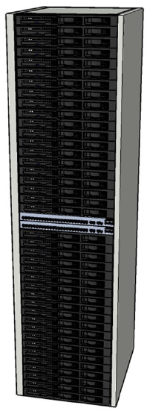
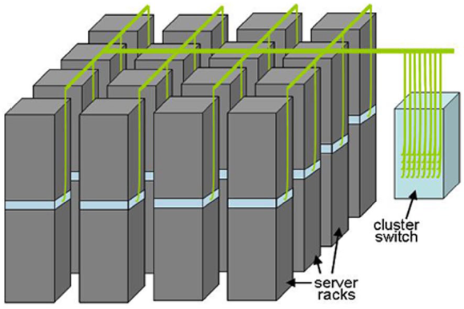
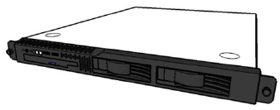
Building Blocks
Single
server
Rack of
servers
Cluster of racks
Source: Barroso and Urs Hölzle (2009)

Slide 4
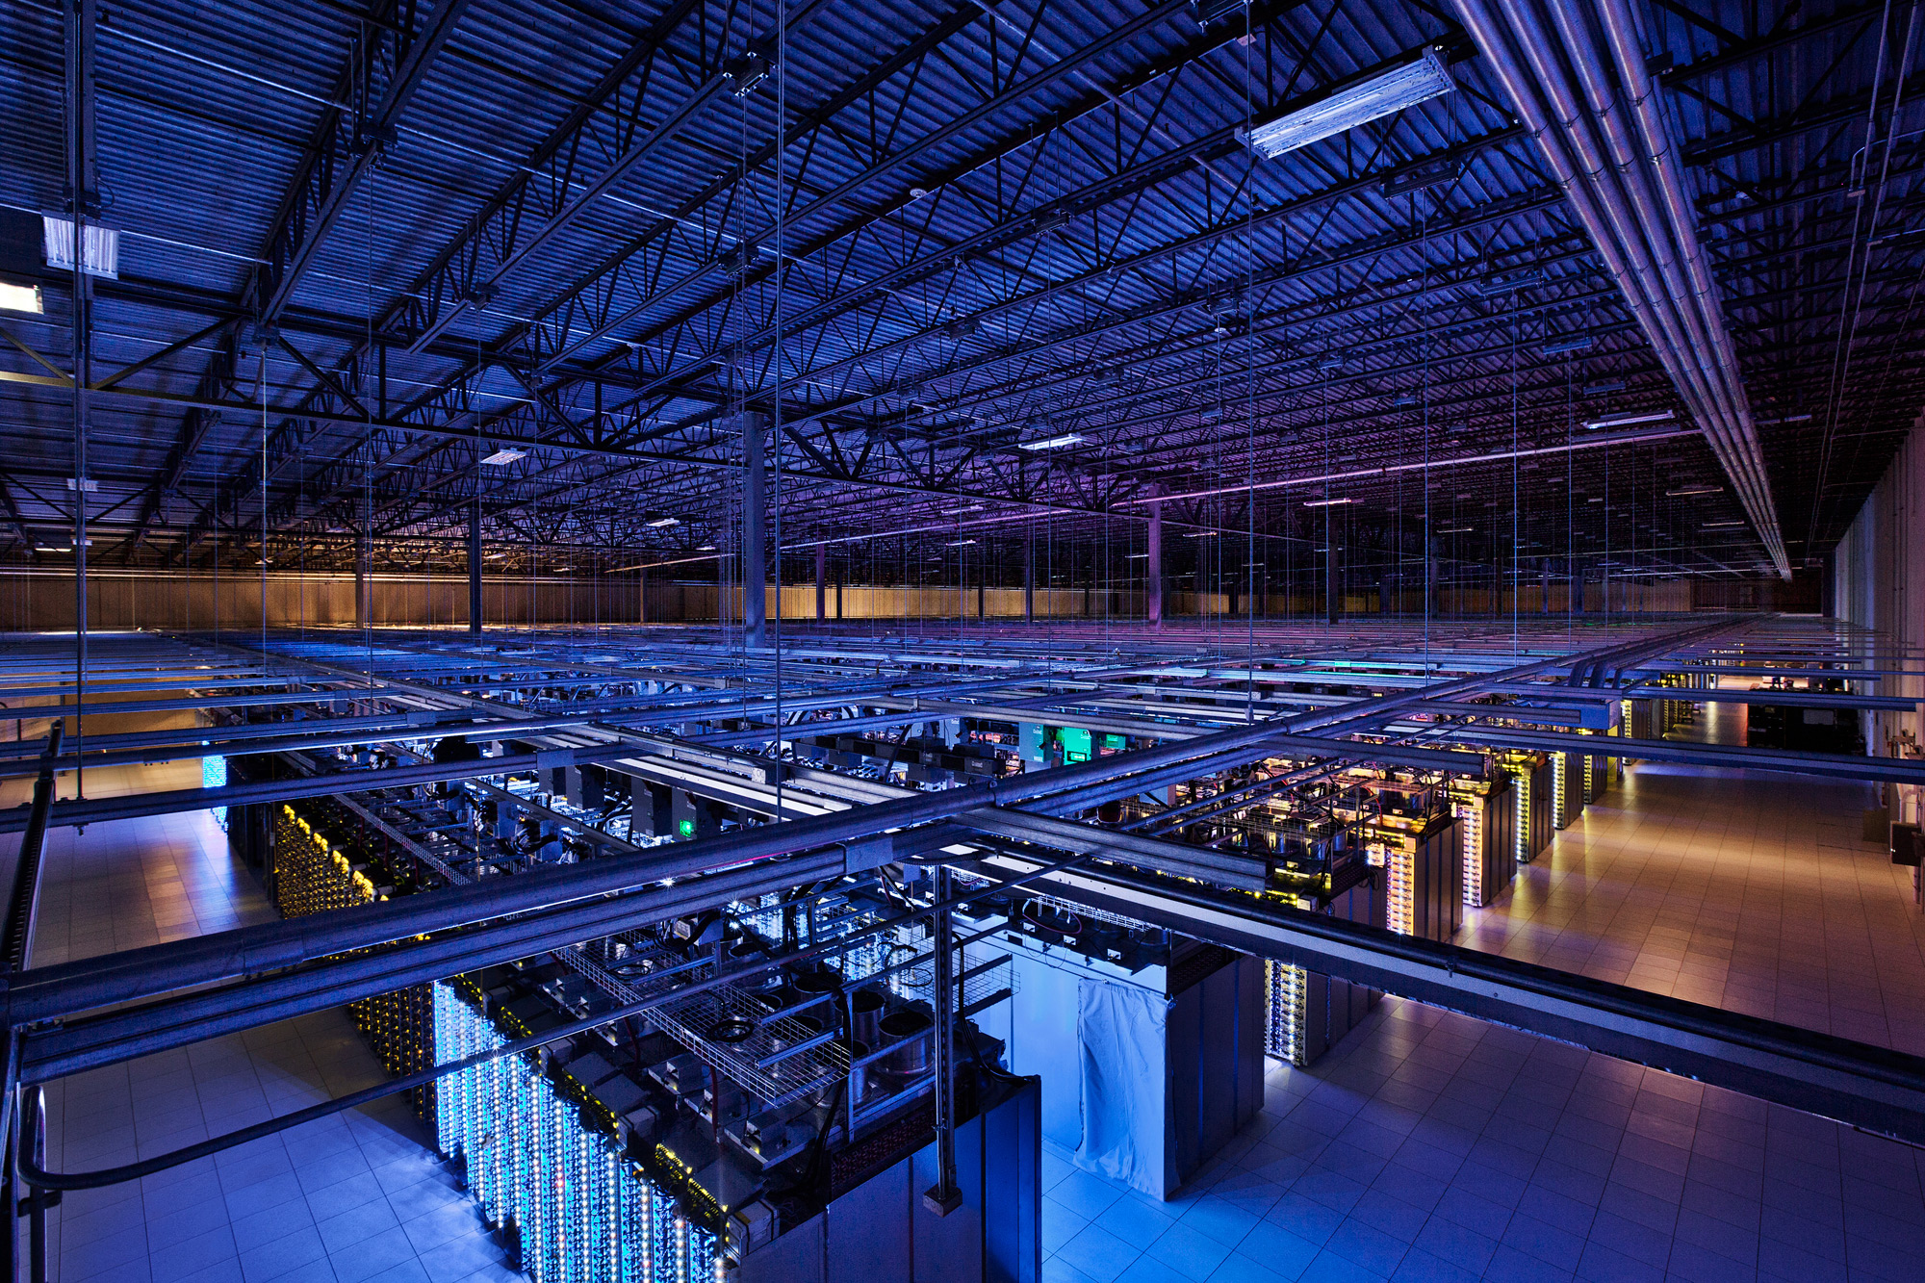
Source: Google

Slide 5
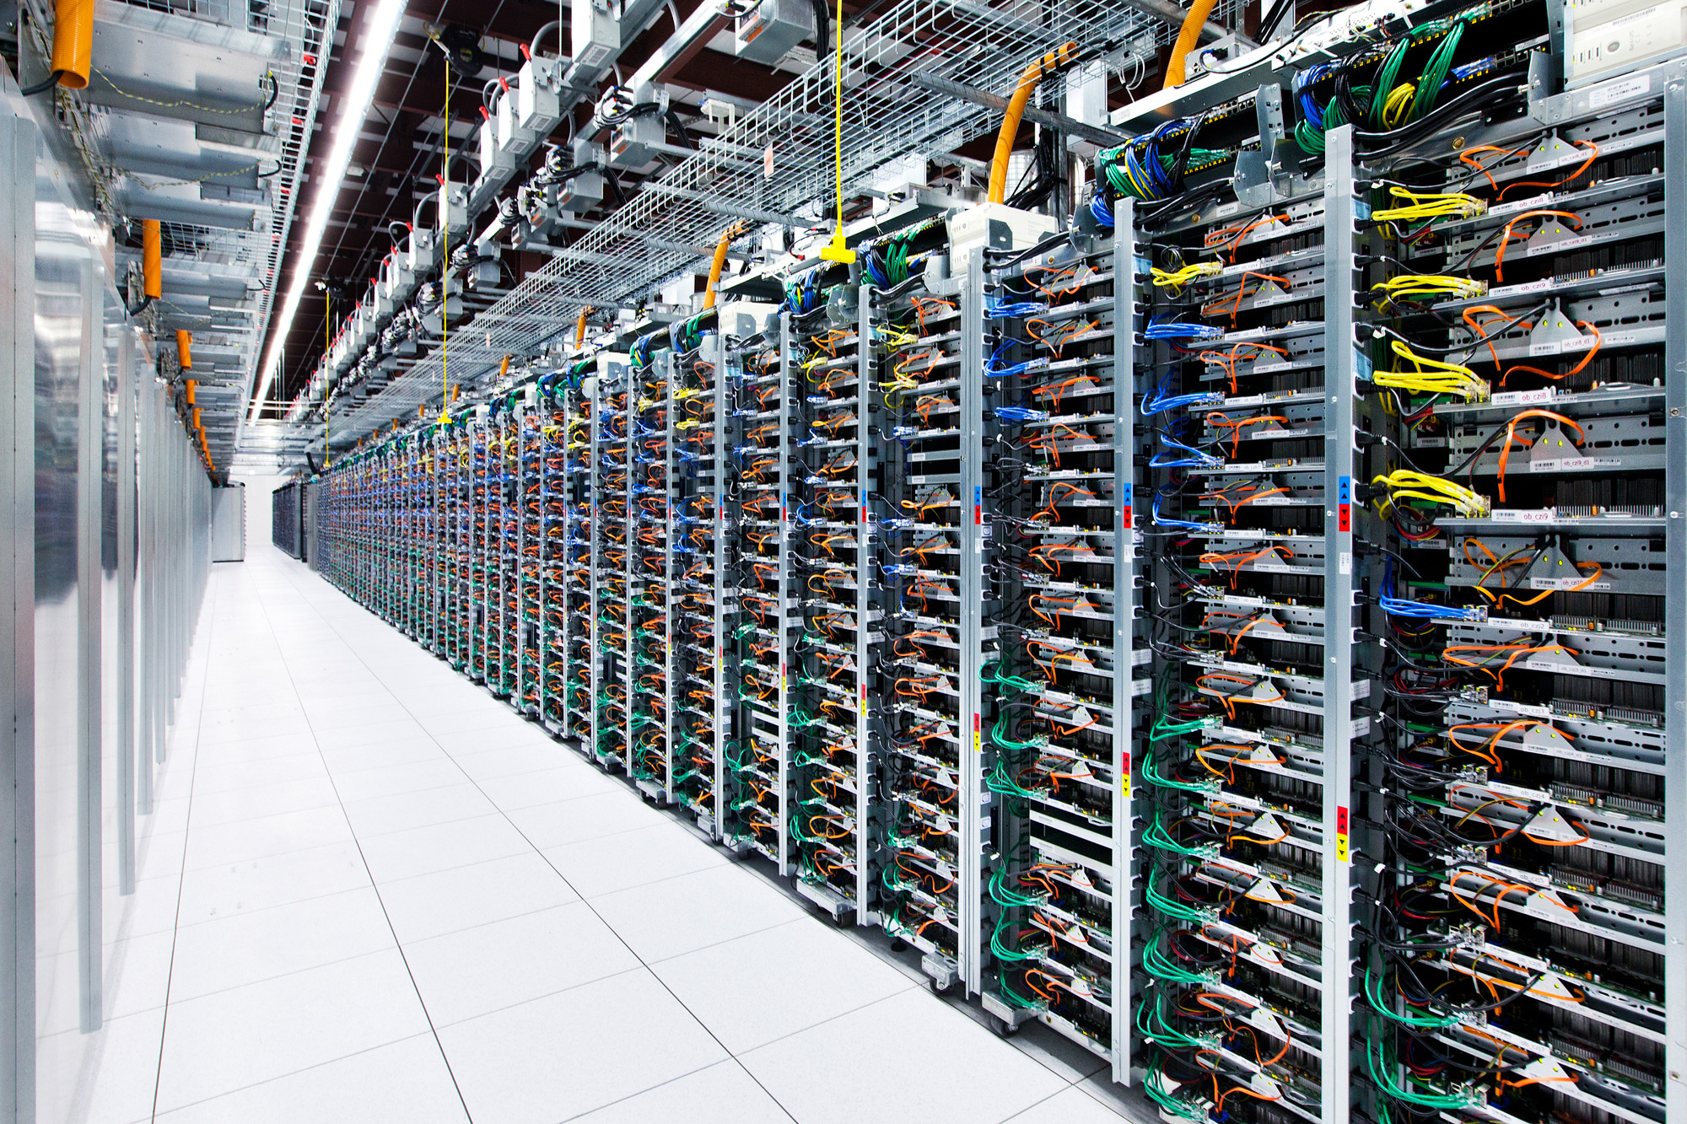
Source: Google

Slide 6
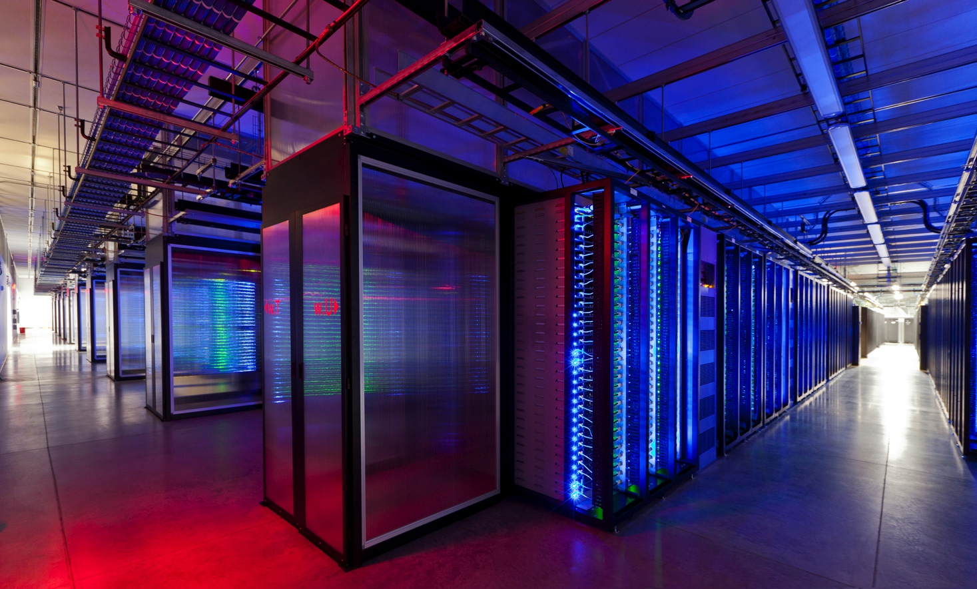
Source: Facebook

Slide 7
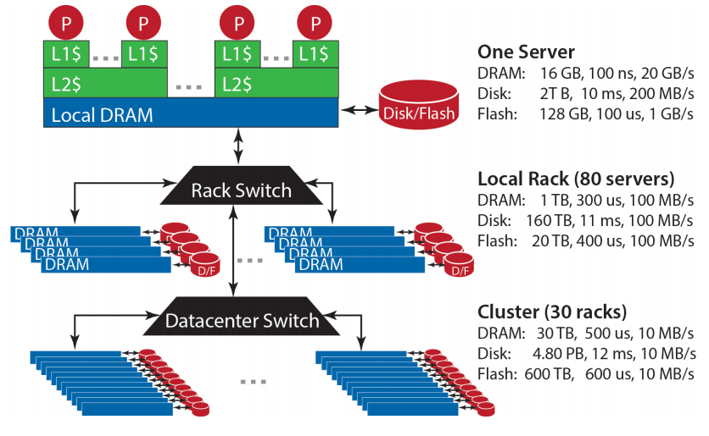
Storage Hierarchy
Source: Barroso and Urs Hölzle (2013)

Slide 8
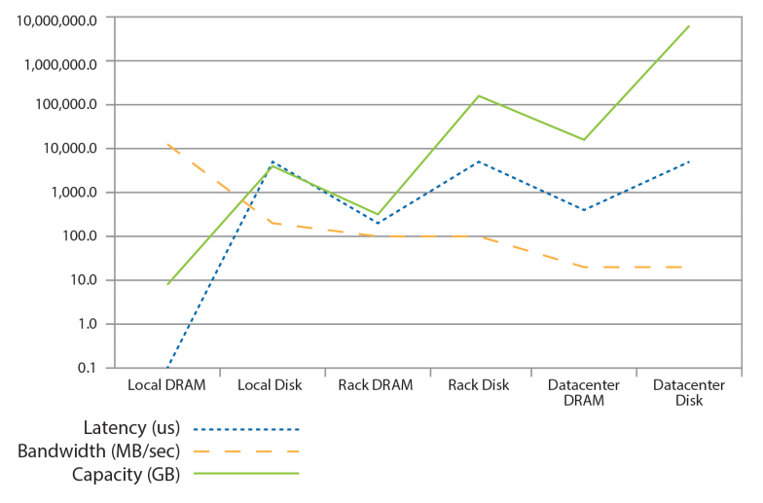
Storage Hierarchy
Source: Barroso and Urs Hölzle (2013)

Slide 9
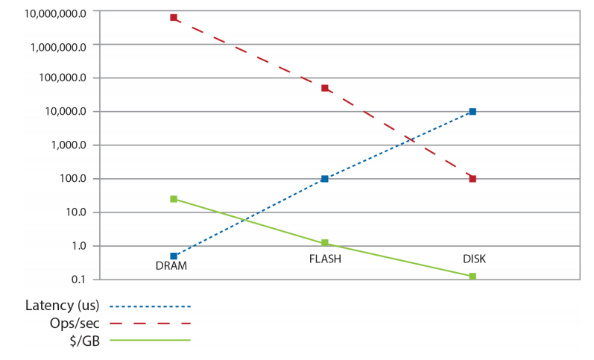
Storage Hierarchy
Source: Barroso and Urs Hölzle (2013)

Slide 10
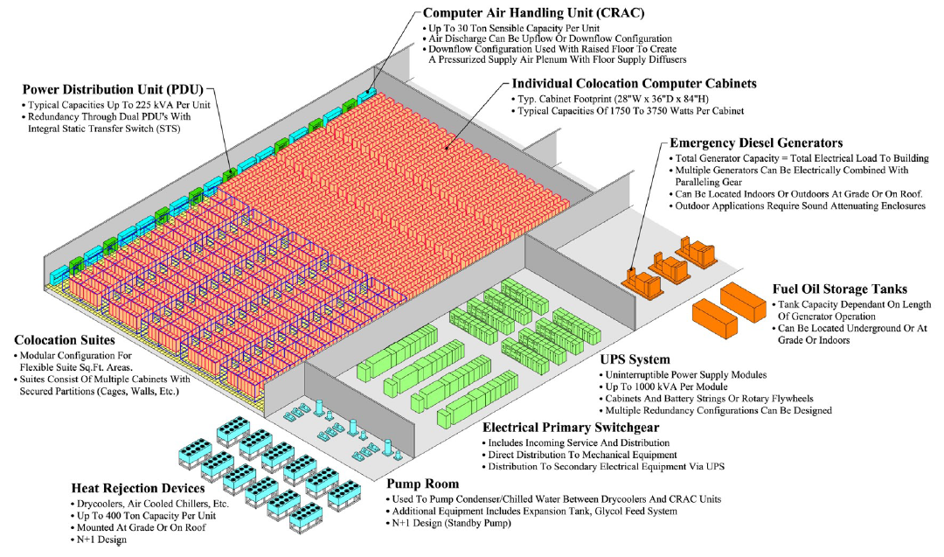
Anatomy of a Datacenter
Source: Barroso and Urs Hölzle (2013)

Slide 11
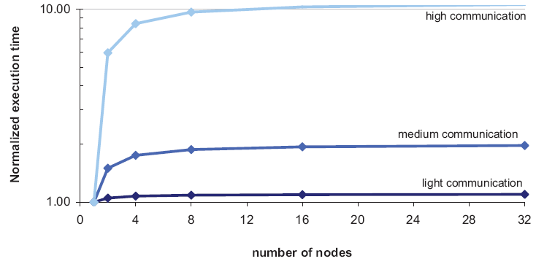
Cost of Parallelization

Slide 12
According to Jeff Dean

Slide 13
Classical Data Processing
Standalone Computer
Data fits into memory
Load data from disk into memory and then process from memory
Data does not fit into memory
Load part of the data from disk into memory
Process the data
CPU
Memory
Disk

Slide 14
Limitation of classical data processing framework

Slide 15
A Simple Example
10 Billion web pages
Average size of webpage: 20 KB
Total 200 TB
Disk read bandwidth = 50 MB / sec
Only reading time: 4 million second = 46+ days
Longer, if you want to do useful analytics with the data

Slide 16

Standard Solution
Use multiple interconnected machine
BIG DATA
1. Split data into small chunks
2. Send different chunks to
different machines and process
3. Collect the results from
different machines
Distributed Data processing in Cluster of Computers

Slide 17
How to Organize Cluster of Computers?

Slide 18
Cluster Architecture: Rack Servers
Backbone switch
(typically 2-10 gbps)
switch
1 gbps between any pair of nodes
switch
switch
computer
computer
computer
computer
Rack 1
Rack 2
Each rack typically contains 16-64 commodity computers (nodes)

Slide 19
Main challenges in Cluster Computing

Slide 20
Challenge # 1
Node failures
Single server lifetime: 1000 days
1000 servers in a cluster => 1 failure/day
1M servers in clusters => 1000 failures/day

Slide 21
Consequences of Node Failure
Data loss
Node failure in the middle of long and expensive computation
Need to restart the computation from scratch

Slide 22
Challenge # 2
Network bottleneck
Computers in a cluster exchange data through network
Moving 10TB of data through 1 gbps network bandwidth takes 1 day

Slide 23
Challenge # 3
Distributed Programming is hard!!!
Why?
Data distribution across machines is non-trivial
(It is desirable that machines have roughly the same load)
Avoiding race conditions

Slide 24
A good Solution
Map-Reduce
A simple programming model
Uses cluster of low-cost computers
Remarkably Scalable for Batch Processing tasks

Slide 25
How does Map-Reduce address the challenges?

Slide 26
Map-Reduce: Addressing the challenges
Data loss prevention
By keeping multiple copies of data in different machines
Data movement minimization
By moving computation to the data
(sends computer program to machines containing data)
Simple programing model
Mainly using two functions
Map
Reduce
Programmer’s responsibility:
Write only two functions, Map and Reduce suitable for your problem
The programmer does not need to worry about other things.

Slide 27
Storing Big Data Distributed File System

Slide 28
Distributed File System
Redundant storage structure
Multiple copies of data are kept in different nodes
Examples:
Google file system (GFS)
HDFS (Hadoop, a open-source system)

Slide 29
Distributed File System
Typical usage pattern
Data is rarely updated in place
Reads and appends are common
Very rare random access

Slide 30
Distributed File System: Inside Look
Data is kept in chunks, spread across machines
Each chunk is replicated on different nodes
Ensures persistence

Slide 31
Distributed File System: Chunk Servers
Example:
We have two files, A and B
3 computers
2 times replication of data
a1 a2 a3
b1 b2
A
B
Here are the Chunk Servers
a1
a2
b1
a1
a3
a3
b1
b2
a2
b2
Chunk servers also serve as compute nodes
Bring computation to the data

